Slide 1
Dynamodb Streams
Anju munoth

Slide 2
DynamoDB Stream
--Stream of observed changes in data, technically called a Change Data Capture (CDC).
Once enabled, whenever you perform a write operation to the DynamoDB table, like put, update or delete, a corresponding event containing information like which record was changed and what was changed will be saved to the Stream in near-real time.
DynamoDB feature that allows users to keep track of any changes made to the data in DynamoDB.
Is an “ordered flow of data” that contains information about changes made to the data in the DynamoDB table.

Slide 3
DynamoDB Stream
Can be used to decouple your application core business logic from effects that should happen afterward.
Base code can be minimal while you can still "plug-in" more Lambda functions reacting to changes as your software evolves.
Enables not only separation of concerns but also better security and reduces the impact of possible bugs.
Streams can be also leveraged to be an alternative for Transactions if consistency and atomicity is not required.
DynamoDB supports streaming of item-level change data capture records in near-real time.
Can build applications that consume these streams and take action based on the contents

Slide 4
When to work with streams
Many applications benefit from capturing changes to items stored in a DynamoDB table, at the point in time when such changes occur
A popular mobile app modifies data in a DynamoDB table, at the rate of thousands of updates per second. Another application captures and stores data about these updates, providing near-real-time usage metrics for the mobile app.
A financial application modifies stock market data in a DynamoDB table. Different applications running in parallel track these changes in real time, compute value-at-risk, and automatically rebalance portfolios based on stock price movements.

Slide 5
When to work with streams
Sensors in transportation vehicles and industrial equipment send data to a DynamoDB table.
Different applications monitor performance and send messaging alerts when a problem is detected, predict any potential defects by applying machine learning algorithms, and compress and archive data to Amazon Simple Storage Service (Amazon S3).
An application automatically sends notifications to the mobile devices of all friends in a group as soon as one friend uploads a new picture.
A new customer adds data to a DynamoDB table. This event invokes another application that sends a welcome email to the new customer.

Slide 6
Streaming options for change data capture
DynamoDB offers two streaming models for change data capture:
Kinesis Data Streams for DynamoDB
DynamoDB Streams.
Can enable both streaming models on the same DynamoDB table

Slide 7
Characteristics of DynamoDB Stream
Events are stored up to 24 hours
Ordered, sequence of events in the stream reflects the actual sequence of operations in the table
Near-real time, events are available in the stream within less than a second from the moment of the write operation
Deduplicated, each modification corresponds to exactly one record within the stream
Noop operations, like PutItem or UpdateItem that do not change the record are ignored

Slide 8
Change data capture for DynamoDB Streams
DynamoDB Streams captures a time-ordered sequence of item-level modifications in any DynamoDB table and stores this information in a log for up to 24 hours.
Applications can access this log and view the data items as they appeared before and after they were modified, in near-real time.
Encryption at rest encrypts the data in DynamoDB streams.
A DynamoDB stream is an ordered flow of information about changes to items in a DynamoDB table.
When you enable a stream on a table, DynamoDB captures information about every modification to data items in the table.

Slide 9
Change data capture for DynamoDB Streams
Whenever an application creates, updates, or deletes items in the table, DynamoDB Streams writes a stream record with the primary key attributes of the items that were modified.
A stream record contains information about a data modification to a single item in a DynamoDB table.
Can configure the stream so that the stream records capture additional information, such as the "before" and "after" images of modified items.
DynamoDB Streams writes stream records in near-real time so that you can build applications that consume these streams and take action based on the contents.
Each stream record appears exactly once in the stream.
For each item that is modified in a DynamoDB table, the stream records appear in the same sequence as the actual modifications to the item

Slide 10
Endpoints for DynamoDB Streams
AWS maintains separate endpoints for DynamoDB and DynamoDB Streams.
To work with database tables and indexes, your application must access a DynamoDB endpoint.
To read and process DynamoDB Streams records, your application must access a DynamoDB Streams endpoint in the same Region.
Naming convention for DynamoDB Streams endpoints is streams.dynamodb.<region>.amazonaws.com.
For example, if you use the endpoint dynamodb.us-west-2.amazonaws.com to access DynamoDB, would use the endpoint streams.dynamodb.us-west-2.amazonaws.com to access DynamoDB Streams.

Slide 11
Endpoints for DynamoDB Streams
AWS SDKs provide separate clients for DynamoDB and DynamoDB Streams.
Depending on requirements, application can access a DynamoDB endpoint, a DynamoDB Streams endpoint, or both at the same time.
To connect to both endpoints, application must instantiate two clients—one for DynamoDB and one for DynamoDB Streams

Slide 12
Enabling a stream
Can enable a stream on a new table when you create it using the AWS CLI or one of the AWS SDKs.
Can also enable or disable a stream on an existing table, or change the settings of a stream.
DynamoDB Streams operates asynchronously, so there is no performance impact on a table if you enable a stream.

Slide 13
Enabling a stream using console
Sign in to the AWS Management Console and open the DynamoDB console at https://console.aws.amazon.com/dynamodb/.
On the DynamoDB console dashboard, choose Tables and select an existing table.
On the Exports and streams tab, in the DynamoDB stream details section, choose Enable.
In the Enable DynamoDB stream window, choose the information that will be written to the stream whenever the data in the table is modified:
Key attributes only — Only the key attributes of the modified item.
New image — The entire item, as it appears after it was modified.
Old image — The entire item, as it appeared before it was modified.
New and old images — Both the new and the old images of the item.
When the settings are as you want them, choose Enable stream.
(Optional) To disable an existing stream, choose Disable under DynamoDB stream details.

Slide 14
Enabling a stream using CLI
Can also use the CreateTable or UpdateTable API operations to enable or modify a stream.
StreamSpecification parameter determines how the stream is configured:
StreamEnabled — Specifies whether a stream is enabled (true) or disabled (false) for the table.
StreamViewType — Specifies the information that will be written to the stream whenever data in the table is modified:
KEYS_ONLY — Only the key attributes of the modified item.
NEW_IMAGE — The entire item, as it appears after it was modified.
OLD_IMAGE — The entire item, as it appeared before it was modified.
NEW_AND_OLD_IMAGES — Both the new and the old images of the item.

Slide 15
Enable/Disable streams
can enable or disable a stream at any time.
Can receive a ResourceInUseException if you try to enable a stream on a table that already has a stream.
Can receive a ValidationException if you try to disable a stream on a table that doesn't have a stream.
When you set StreamEnabled to true, DynamoDB creates a new stream with a unique stream descriptor assigned to it.
If you disable and then re-enable a stream on the table, a new stream is created with a different stream descriptor.
Every stream is uniquely identified by an Amazon Resource Name (ARN).

Slide 16
Stream Records
A stream consists of stream records.
Each stream record represents a single data modification in the DynamoDB table to which the stream belongs.
Each stream record is assigned a sequence number, reflecting the order in which the record was published to the stream.
Stream records are organized into groups, or shards.
Each shard acts as a container for multiple stream records, and contains information required for accessing and iterating through these records.
The stream records within a shard are removed automatically after 24 hours.

Slide 17
Stream Records
Shards are ephemeral:
Are created and deleted automatically, as needed.
Any shard can also split into multiple new shards; this also occurs automatically
Also possible for a parent shard to have just one child shard.
A shard might split in response to high levels of write activity on its parent table, so that applications can process records from multiple shards in parallel.
Because shards have a lineage (parent and children), an application must always process a parent shard before it processes a child shard.
Helps ensure that the stream records are also processed in the correct order.

Slide 18
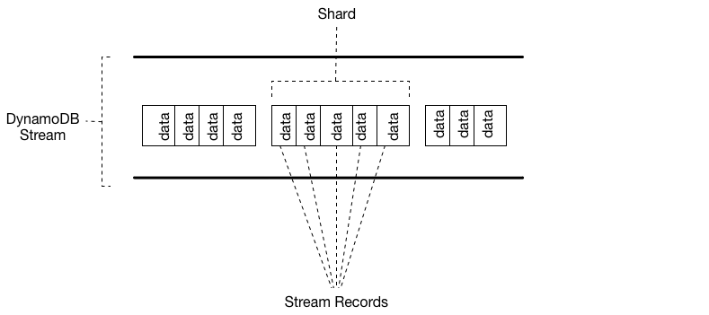

Slide 19
Anatomy of DynamoDB Stream
Stream consists of Shards.
Each Shard is a group of Records, where each record corresponds to a single data modification in the table related to that stream.
Shards are automatically created and deleted by AWS.
Shards also have a possibility of dividing into multiple shards, and this also happens without our action.
Moreover, when creating a stream you have few options on what data should be pushed to the stream. Options include:
OLD_IMAGE - Stream records will contain an item before it was modified
NEW_IMAGE - Stream records will contain an item after it was modified
NEW_AND_OLD_IMAGES - Stream records will contain both pre and post-change snapshots
KEYS_ONLY - Self-explanatory

Slide 20
Data retention limit for DynamoDB Streams
All data in DynamoDB Streams is subject to a 24-hour lifetime.
Can retrieve and analyze the last 24 hours of activity for any given table.
Data that is older than 24 hours is susceptible to trimming (removal) at any moment.
If you disable a stream on a table, the data in the stream continues to be readable for 24 hours.
After this time, the data expires and the stream records are automatically deleted.
No mechanism for manually deleting an existing stream.
Must wait until the retention limit expires (24 hours), and all the stream records will be deleted.

Slide 21
DynamoDB integrate with AWS Lambda
DynamoDB offers a tight integration with AWS Lambda via DynamoDB Streams.
With DynamoDB Streams, can configure an AWS Lambda function to be run every time there is an update to your DynamoDB table.
With this functionality you can send out transactional emails, update the records in other tables and databases, run periodic cleanups and table rollovers, implement activity counters, and much more.

Slide 22
DynamoDB Lambda Trigger
DynamoDB Streams works particularly well with AWS Lambda due to its event-driven nature.
They scale to the amount of data pushed through the stream and streams are only invoked if there's data that needs to be processed.

Slide 23
Filtering DynamoDB Stream events
Recently announced features of Lambda function --Ability to filter events, including these coming from a DynamoDB Stream.
Filtering is especially useful if you want to process only a subset of the events in the stream, e.g. only events that are deleting records or updating a specific entity.
Also a great way to reduce the amount of data that your Lambda function processes - it drives the operational burden and costs down.

Slide 24
DynamoDB Streams and Time to Live
Can back up, or otherwise process, items that are deleted by Time to Live (TTL) by enabling Amazon DynamoDB Streams on the table and processing the streams records of the expired items.
Streams record contains a user identity field Records[<index>].userIdentity.
Items that are deleted by the Time to Live process after expiration have the following fields:
Records[<index>].userIdentity.type
"Service"
Records[<index>].userIdentity.principalId
"dynamodb.amazonaws.com"

Slide 25
Using DynamoDB Streams and Lambda to archive TTL deleted items
Combining DynamoDB Time to Live (TTL), DynamoDB Streams, and AWS Lambda can help simplify archiving data, reduce DynamoDB storage costs, and reduce code complexity.
Using Lambda as the stream consumer provides many advantages, most notably the cost reduction compared to other consumers such as Kinesis Client Library (KCL).
You aren’t charged for GetRecords API calls on your DynamoDB stream when using Lambda to consume events, and Lambda can provide event filtering by identifying JSON patterns in a stream event.
With event-pattern content filtering, you can define up to five different filters to control which events are sent to Lambda for processing.
This helps reduce invocations of your Lambda functions, simplifies code, and reduces overall cost.

Slide 26
Using DynamoDB Streams and Lambda to archive TTL deleted items
While DynamoDB Streams contains all data modifications, such as Create, Modify, and Remove actions, this can result in unwanted invocations of your archive Lambda function.
For example, say you have a table with 2 million data modifications per hour flowing into the stream, but less than 5 percent of these are item deletes that will expire through the TTL process and need to be archived.
With Lambda event source filters, the Lambda function will only invoke 100,000 times per hour.
The result with event filtering is that you’re charged only for the needed invocations instead of the 2 million invocations you would have without event filtering.

Slide 27
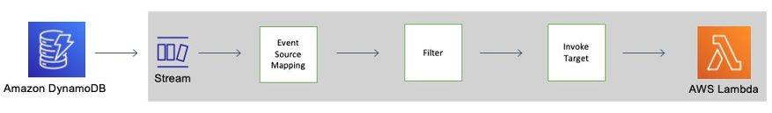
Using DynamoDB Streams and Lambda to archive TTL deleted items
Event filtering is applied to the Lambda event source mapping, which is a resource that reads from a chosen event—the DynamoDB stream—and invokes a Lambda function.
In the following diagram, can see how a Time to Live deleted item is consumed by a Lambda function using streams and event filters

Slide 28
DynamoDB Streams and AWS Lambda triggers
Amazon DynamoDB is integrated with AWS Lambda so that you can create triggers—pieces of code that automatically respond to events in DynamoDB Streams.
With triggers, you can build applications that react to data modifications in DynamoDB tables.
If you enable DynamoDB Streams on a table, you can associate the stream Amazon Resource Name (ARN) with an AWS Lambda function that you write.
All mutation actions to that DynamoDB table can then be captured as an item on the stream.
For example, you can set a trigger so that when an item in a table is modified a new record immediately appears in that table's stream.

Slide 29
DynamoDB Streams and AWS Lambda triggers
AWS Lambda service polls the stream for new records four times per second.
When new stream records are available, your Lambda function is synchronously invoked.
Can subscribe up to two Lambda functions to the same DynamoDB stream.
Lambda function can send a notification, initiate a workflow, or perform many other actions that you specify.
Can write a Lambda function to simply copy each stream record to persistent storage, such as Amazon S3 File Gateway (Amazon S3), and create a permanent audit trail of write activity in your table.

Slide 30
DynamoDB Streams and AWS Lambda triggers
Have a mobile gaming app that writes to a GameScores table.
Whenever the TopScore attribute of the GameScores table is updated, a corresponding stream record is written to the table's stream.
This event could then trigger a Lambda function that posts a congratulatory message on a social media network.
This function could also be written to ignore any stream records that are not updates to GameScores, or that do not modify the TopScore attribute.

Slide 31
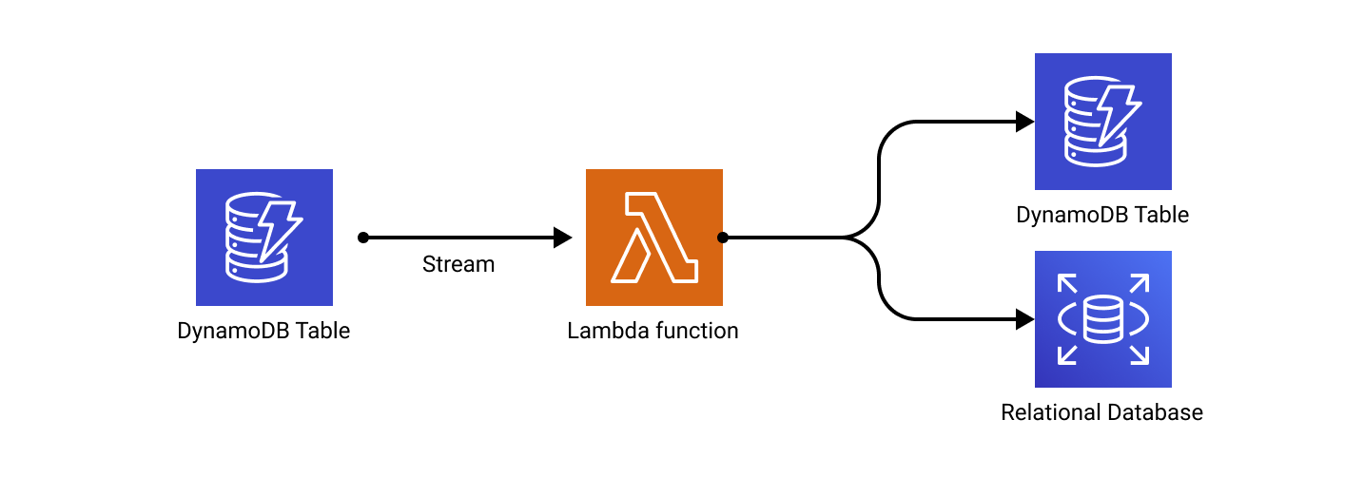
Use Cases
Data replication
Even though cross-region data replication can be solved with DynamoDB Global tables, may still want to replicate your data to DynamoDB table in the same region or push it to RDBMS or S3.
DynamoDB Streams are perfect for that.

Slide 32
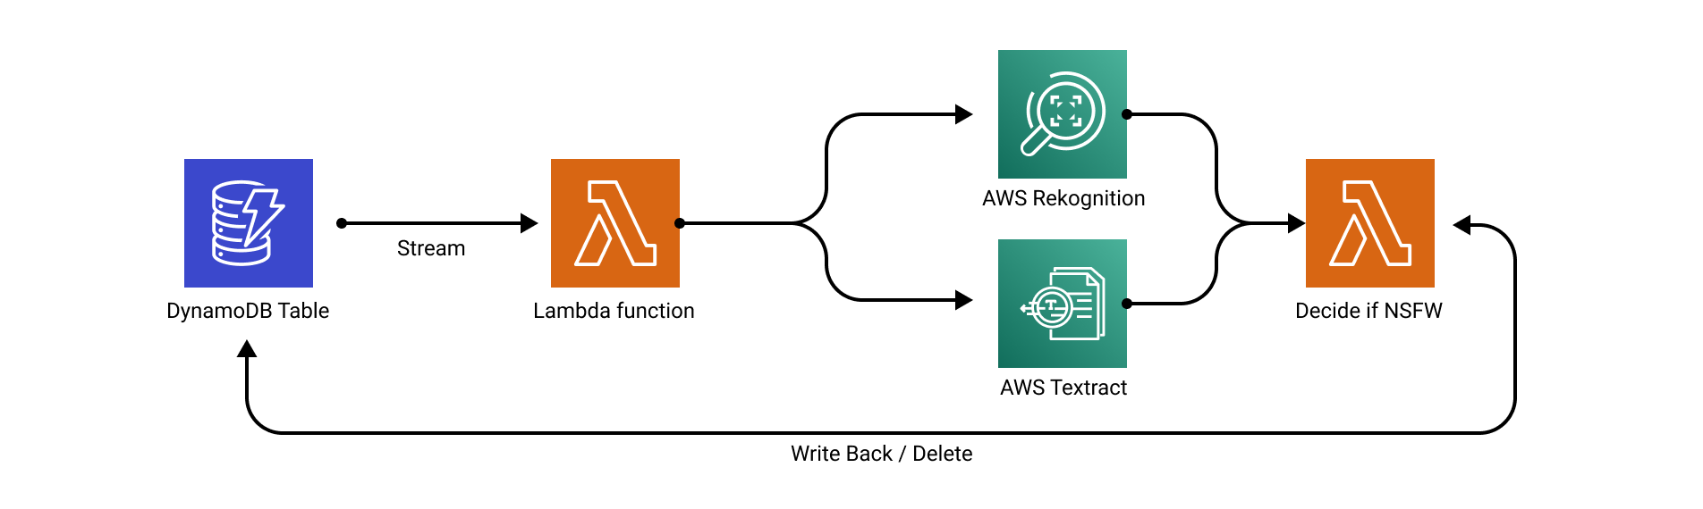
Content moderation
Useful for writing "middlewares".
Can easily decouple business logic with asynchronous validation or side-effects.
Once a message or image is added to a table, DynamoDB Stream passes that record to the Lambda function, which validates it against AWS Artificial Intelligence services such as AWS Rekognition or AWS Comprehend.

Slide 33
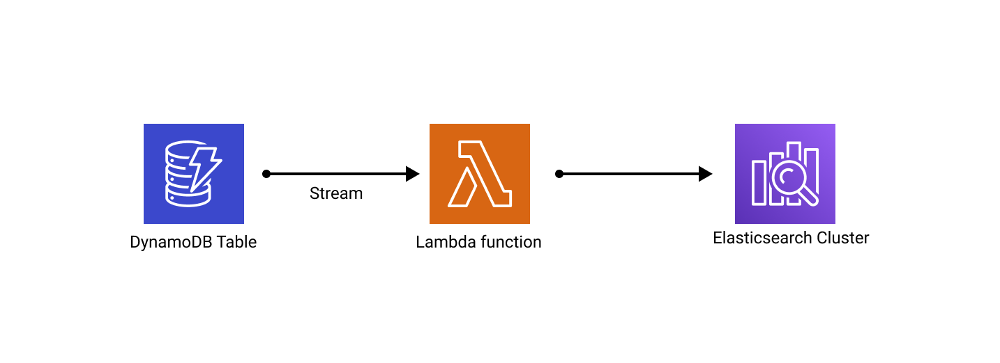
Search
Sometimes the data must also be replicated to other sources, like Elasticsearch where it could be indexed in order to make it searchable. DynamoDB Streams allow that too.

Slide 34
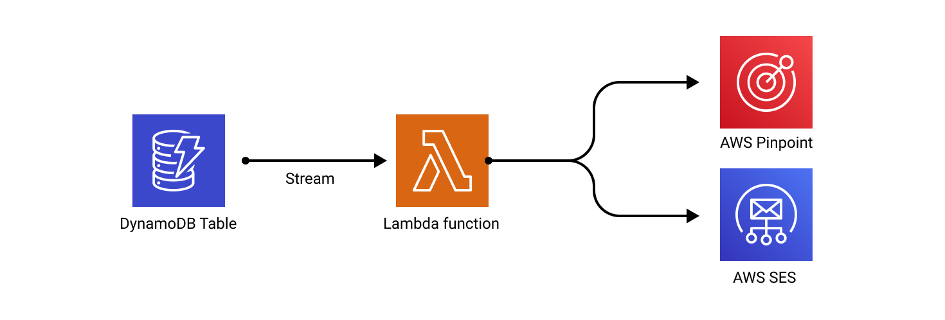
Notifications and sending e-mails
Once the message is saved to DynamoDB table, Lambda function which subscribes to that stream, invokes AWS Pinpoint or SES to notify recipients about it.

Slide 35
Best practices
Be aware of the eventual consistency of the solution.
DynamoDB Stream events are near-real time but not real-time.
There will be small delay between the time of the event and the time of the event delivery.
Be aware of constraints - events in the stream are retained for 24 hours, only two processes can be reading from a single stream shard at a time
To achieve best separation of concerns, use one Lambda function per DynamoDB Stream.
Will help you keep IAM permissions minimal and code as simple as possible
Handle failures. Wrap whole processing logic in a try/catch clause, store the failed event in a DLQ (Dead Letter Queue) and retry them later.

Slide 36
Properties | Kinesis Data Streams for DynamoDB | DynamoDB Streams
Data retention | Up to 1 year. | 24 hours.
Kinesis Client Library (KCL) support | Supports KCL versions 1.X and 2.X. | Supports KCL version 1.X.
Number of consumers | Up to 5 simultaneous consumers per shard, or up to 20 simultaneous consumers per shard with enhanced fan-out. | Up to 2 simultaneous consumers per shard.
Throughput quotas | Unlimited. | Subject to throughput quotas by DynamoDB table and AWS Region.
Record delivery model | Pull model over HTTP using GetRecords and with enhanced fan-out, Kinesis Data Streams pushes the records over HTTP/2 by using SubscribeToShard. | Pull model over HTTP using GetRecords.

Slide 37
Properties | Kinesis Data Streams for DynamoDB | DynamoDB Streams
Ordering of records | The timestamp attribute on each stream record can be used to identify the actual order in which changes occurred in the DynamoDB table. | For each item that is modified in a DynamoDB table, the stream records appear in the same sequence as the actual modifications to the item.
Duplicate records | Duplicate records might occasionally appear in the stream. | No duplicate records appear in the stream.
Stream processing options | Process stream records using AWS Lambda, Kinesis Data Analytics, Kinesis data firehose , or AWS Glue streaming ETL. | Process stream records using AWS Lambda or DynamoDB Streams Kinesis adapter.
Durability level | Availability zones to provide automatic failover without interruption. | Availability zones to provide automatic failover without interruption.

